Slide 1
PoC: LLM-driven Ontology
The PoC covers:
Structured and unstructured illustrative data about products and logistics.
LLM agents that generate ontologies and retrieve data to answer users’ questions.
The PoC presents how I would approach some issues of
Ontologies-LLM integration in a (simplified) edge-case scenario.

Slide 2
How to Build Logic Models That Handle Complex Data?
LLM can generate consistent logic models, also when the prior knowledge (e.g., documents and prompts) is qualitative and partial.
LLM can overcome issues of traditional expert systems since hand-made data models often are unreliable and hard to maintain/extend.
The PoC stresses this aspect by providing
limited prior knowledge to LLM prompts.
However, when available, more detailed information about the scenario and tasks will likely increase accuracy.

Slide 3
How Can LLM Leverage Ontologies to Retrieve Data?
Highly linked data is well-suited for being contextualised in an ontology that the LLM can explore and benefit from (e.g., via SPARQL queries).
At the cost of system complexity, ontologies have several benefits. For example, they support sparse data retrieval, explainability, context-based agent orchestration, consistency checking and error recovery.
The PoC stresses this aspect by enabling the LLM
to retrieve data through SPARQL instead of vector search.
However, a combination of vector-search and queries would increase accuracy and decrease computation time.

Slide 4
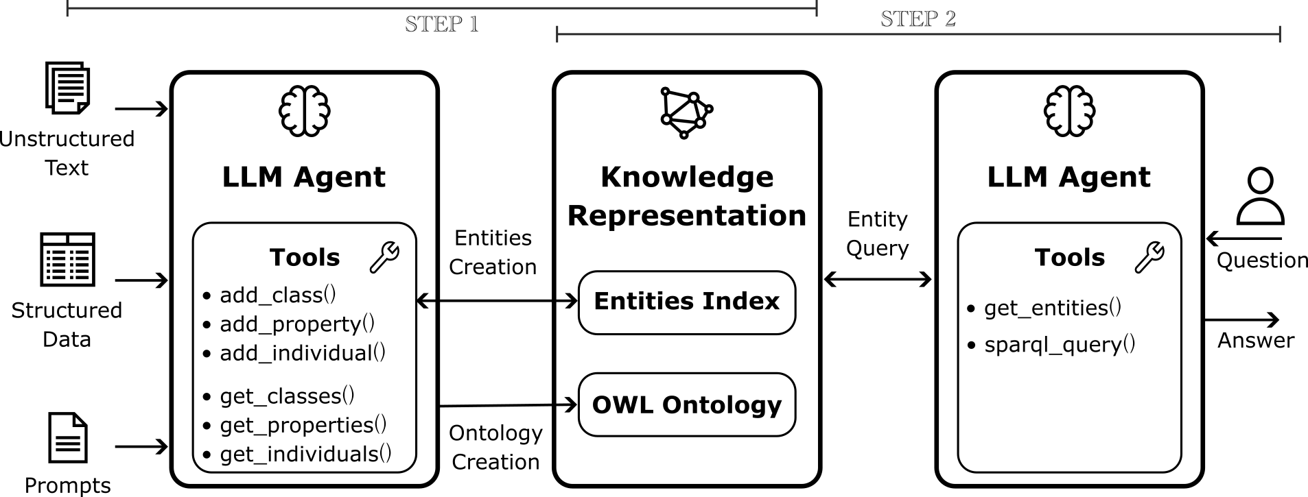
Implementation

Slide 5
Results
Step 1: Ontology Creation
The LLM represented structured data in the ontology better than unstructured text.
The LLM annotated ontological entities to enhance reasoning based on natural language.
The generated ontology (about 900 facts) had few redundancies and was human-readable.
Step 2: Data Retrieval
The LLM explored the ontology and found each answer with 1 or 2 queries.
Over 20 questions: 16 were correct, 1 was partially correct, 1 was incorrect, and 3 had no answer.
The LLM explained the performed queries in a reproducible manner.

Slide 6
Limitations and Improvements
The PoC has a large room for improvement, especially when addressing these limitations:
The implemented LLM tools address a fragment of the OWL formalism, and they do not allow for automatic instance classification.
OWL Reasoners have not been used to support LLM. For example, they could provide consistency feedbacks to the LLM for self-improvement and error recovery.
LLM with limited prior knowledge generates granular ontologies. More prior knowledge and a fine-tuned LLM would decrease the number of facts in the ontology with no semantic loss.
The PoC does not implement concurrent LLM agents, which would decrease computation time.
Retrieving data only with SPARQL is an extreme case. Ontologies integrated with Graph or Vector DBs would improve data retrieval performance.

Slide 7
Thanks for your attention
More details are available in the PoC repository:
___________________________________________
Luca Buoncompagni
06/11/2025

